Slide 1
Genome resolved metagenomics
http://merenlab.org/momics

Slide 2
Notes:
Let’s say you have an environment filled with microbial cells.

Slide 3
Notes:
Shotgun sequencing allows you to sequence the entire DNA content of this environment

Slide 4
Notes:
In the form of ‘short sequencing reads’.
Q: Why are they short?

Slide 5
Notes:
We call these reads often metagenomics short reads.
This type of data can be used in multiple ways to understand the microbial make up of an environment at the DNA level.
Q: What can we do with these reads?
We can align them to databases to estimate functions and taxonomy, and crate summary matrices to compare different environments, for instance.
Q: Can you list some of the caveats of doing that?
Alternatively we can use metagenomic reads to estimate the ‘occurrence’ of a genome in an environment. Which is an extremely powerful approach to probe naturally occurring microbes.

Slide 6
Notes:
Let’s say we have a reference genome.

Slide 7
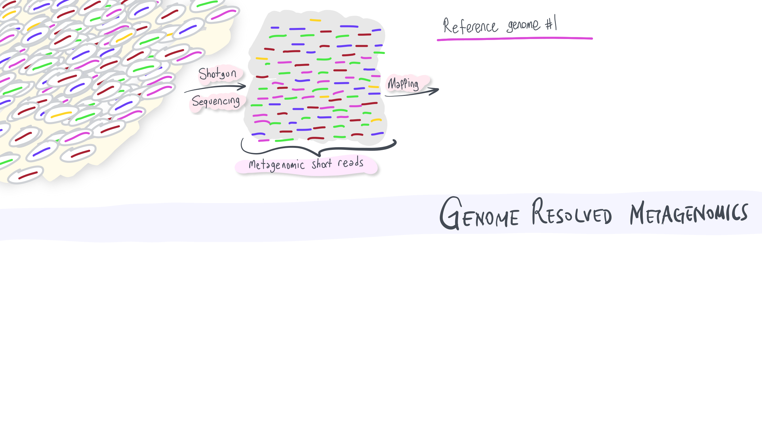

Slide 8
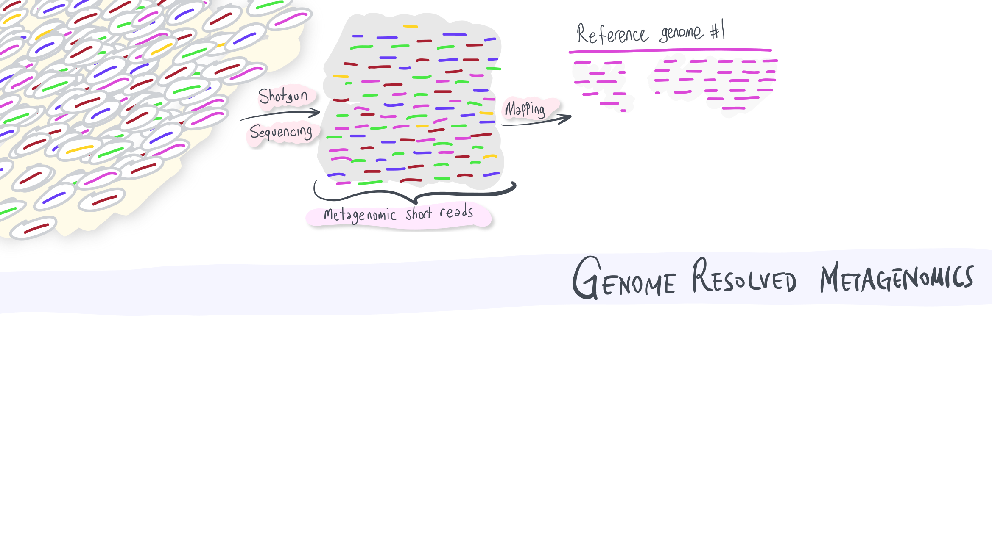
Notes:
As we discussed before, we can use metagenomic read recruitment to understand whether there is a population that occurs in this environment (‘metagenomic read recruitment’ is also called ‘mapping’ pretty frequently, but I like read recruitment better because it associates this operation with an ‘intention’: recruiting reads with a reference sequence to probe its occurrence and abundance in a given metagenome).

Slide 9
Notes:
One could use more genomes, indeed. Let’s say we used these two.

Slide 10
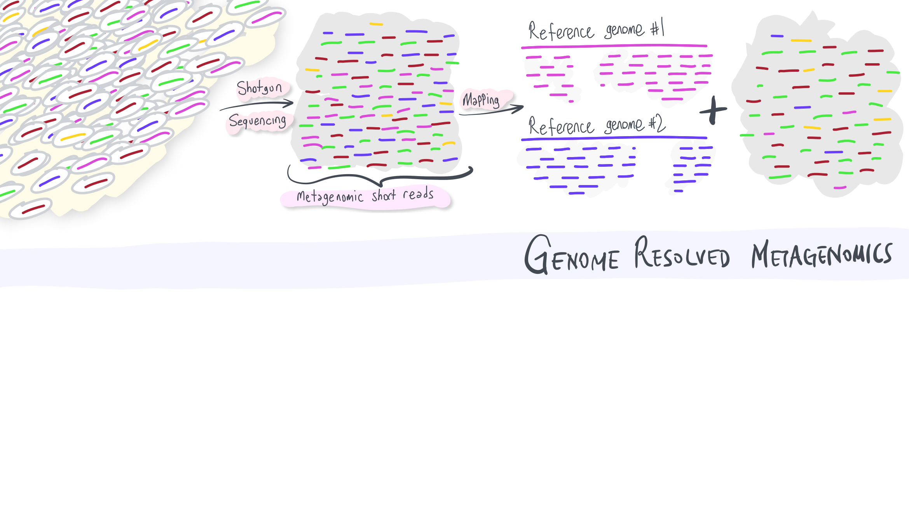
Notes:
What is left behind are the reads that didn’t map either of the genomes we have used.
Q: There are still purple and blue reads in there, why?
Even if there were hundreds of genomes in our genomic database, there would still be some that would remain.
Q: What could be an alternative strategy to characterize an environment with a larger reference context?

Slide 11
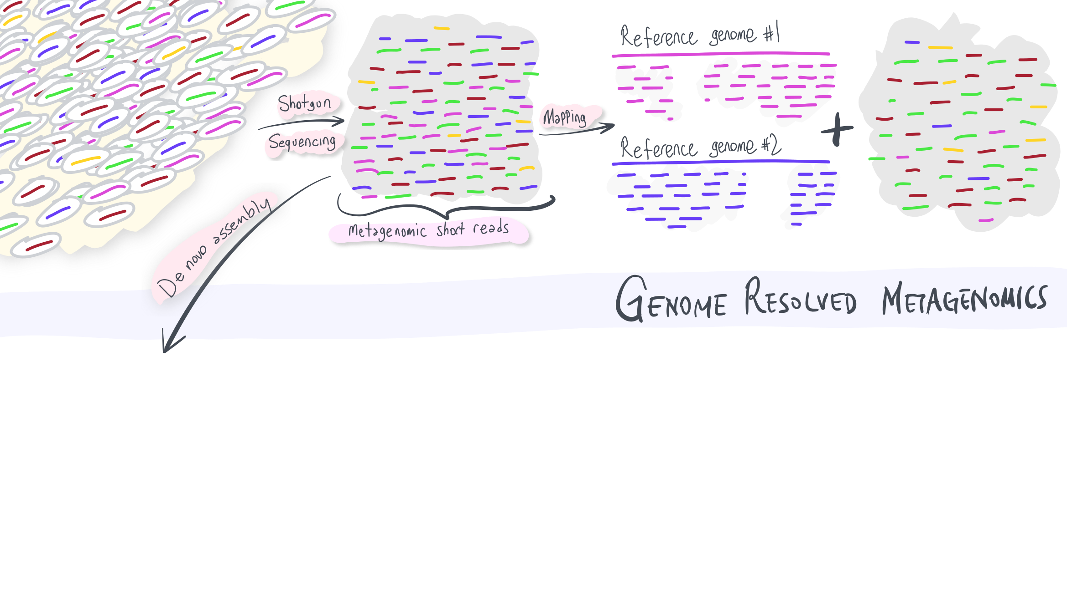
Notes:
We could generate those reference context ourselves!
Metagenomic assembly is a computational strategy to generate longer sequences by stitching partially overlapping short reads together.

Slide 12
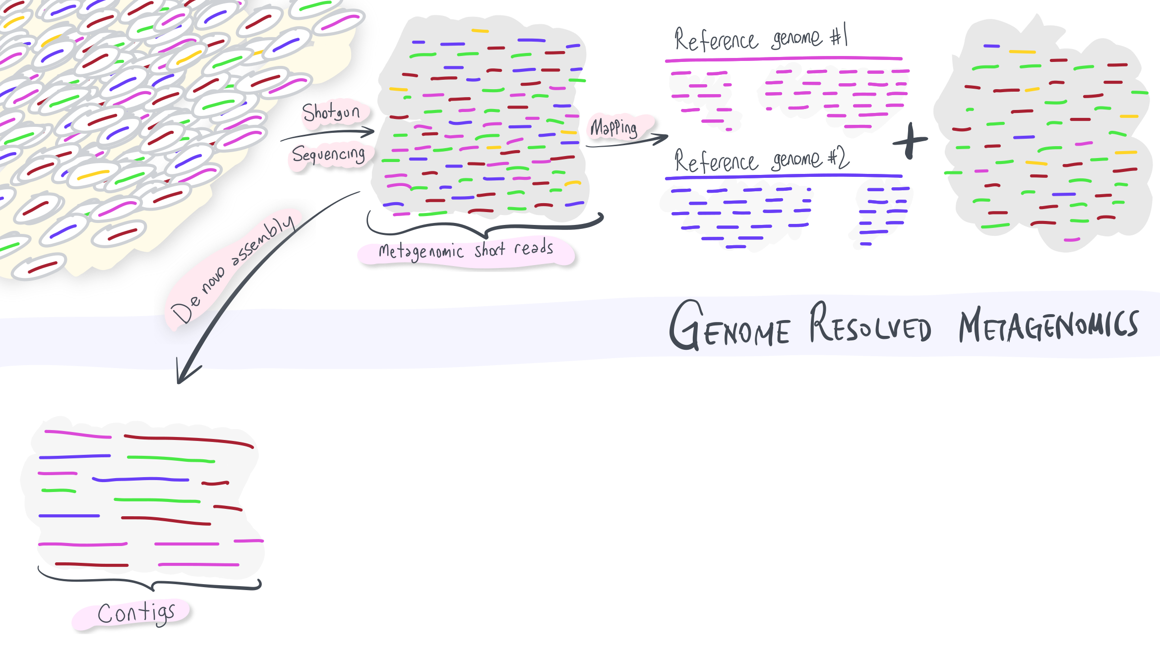
Notes:
We call these longer sequences ‘contigs’ (as in ‘contiguous DNA’). Just like the short reads, contigs also can be aligned to databases for to study functions of genes they describe. For that purpose contigs would work better than short reads.
Q: Do you agree? Why?

Slide 13
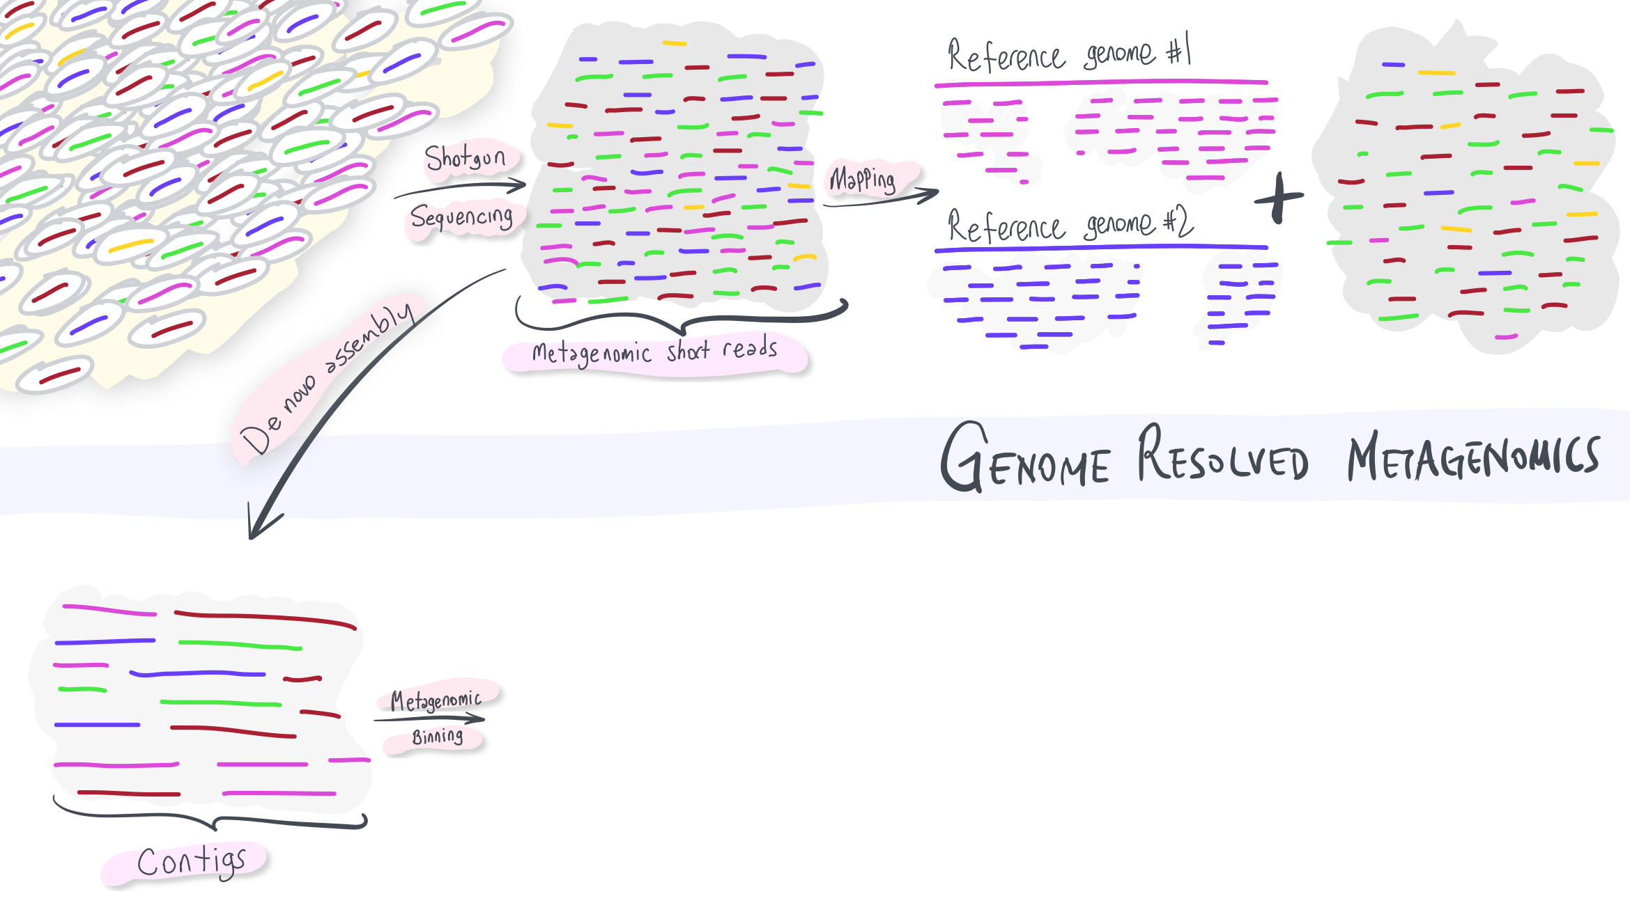
Notes:
But contigs can also be used for something more: the holy grail of microbiology. Reconstructing genomes of microorganisms we have not yet cultivated directly from the environmental samples.
We will talk about the details of this step next week.

Slide 14
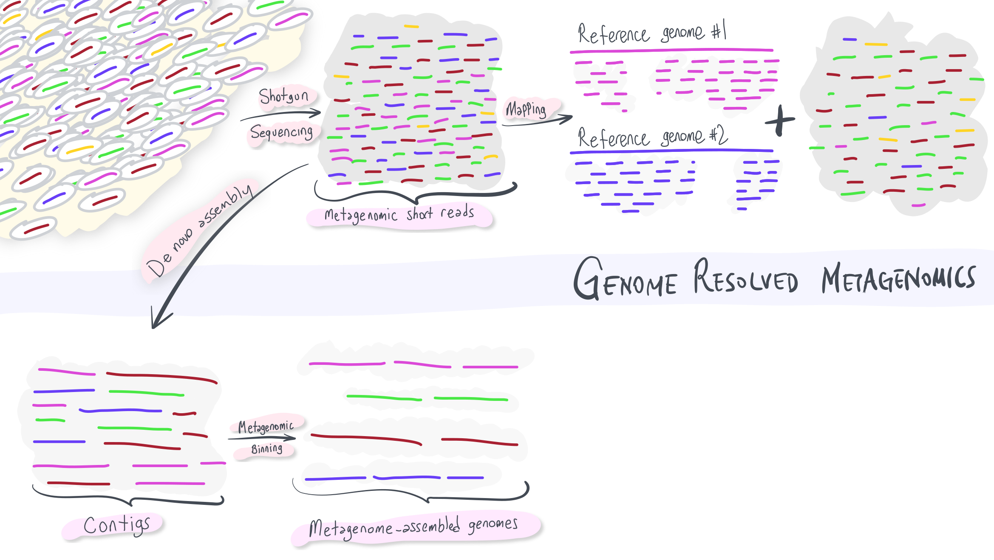
Notes:
But essentially, when done right, metagenomic binning would give us genomes, which we call ‘metagenome-assembled genomes’.
Q: Why are there multiple ‘contigs’ for a given genome rather than a single one?
Q: Can we estimate the abundance of these MAGs? How?

Slide 15
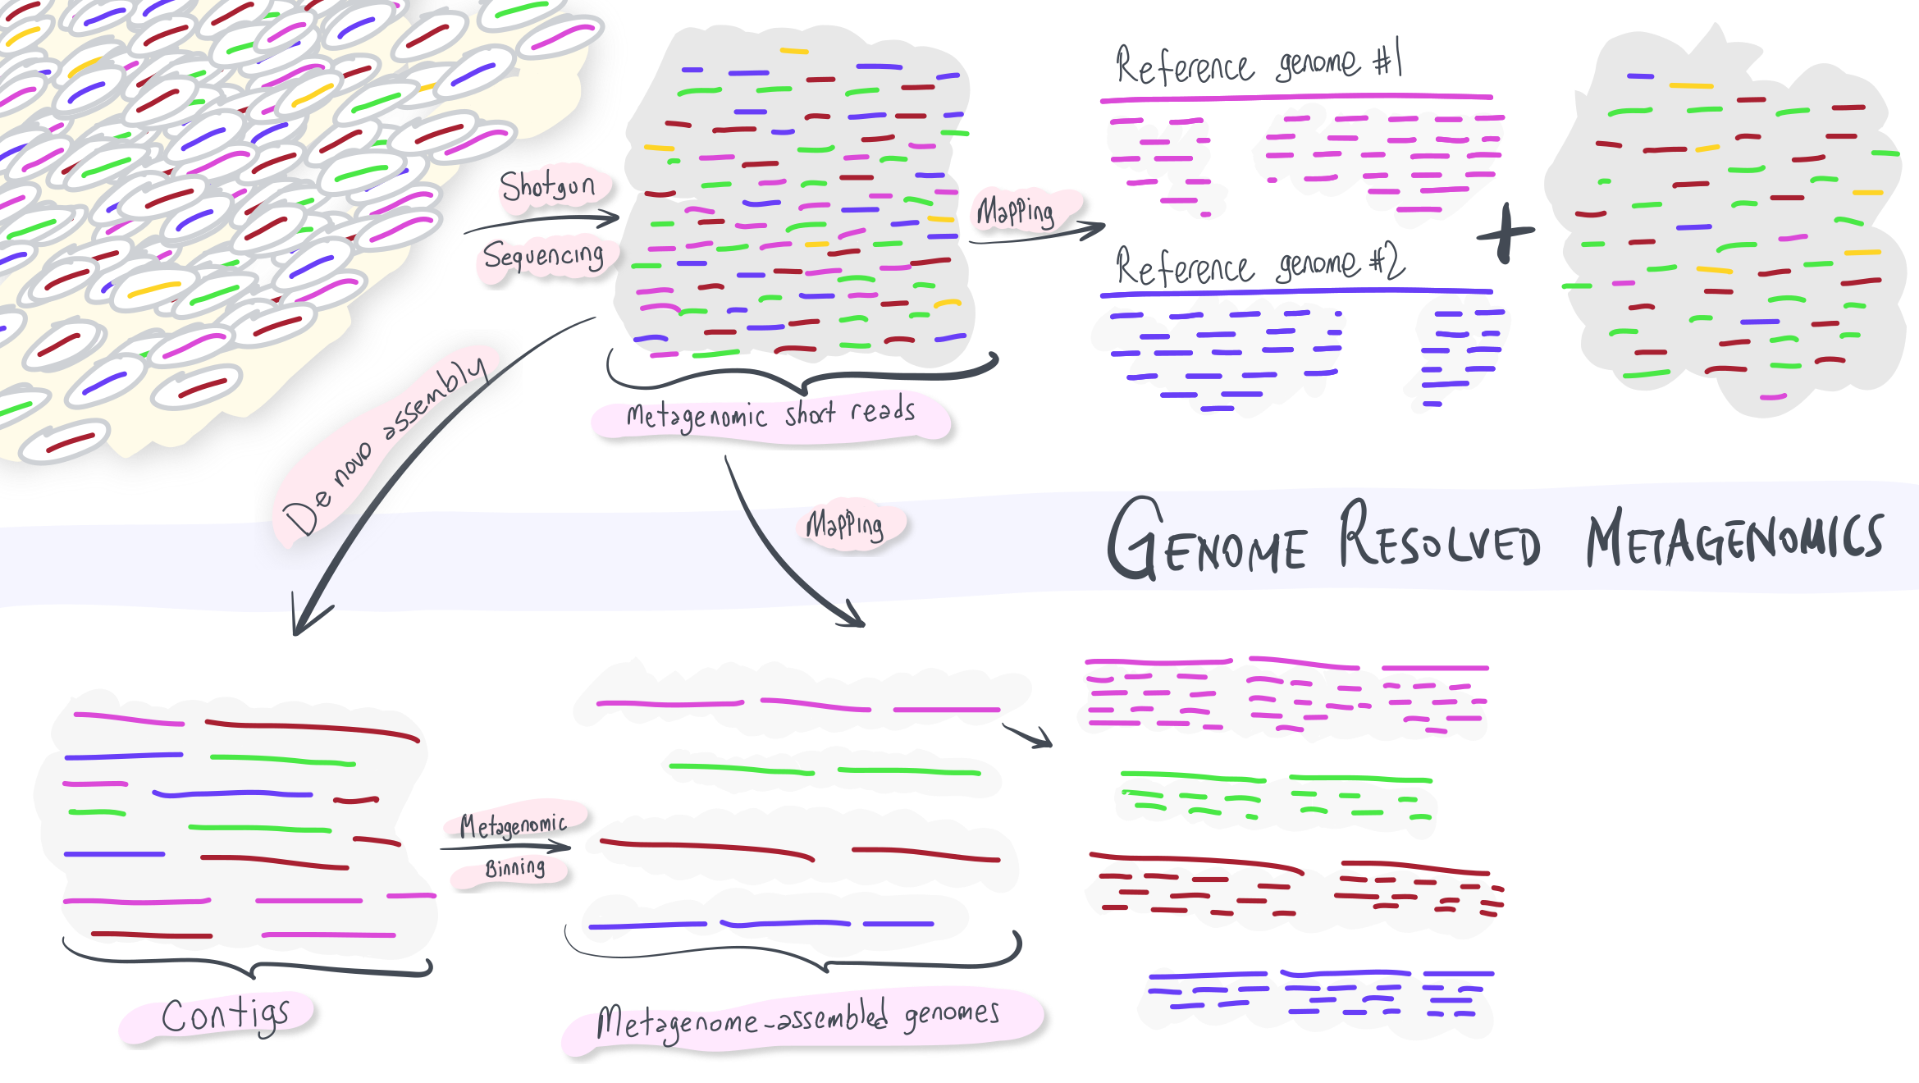
Notes:
The same strategy of mapping will also work with these sequences.

Slide 16
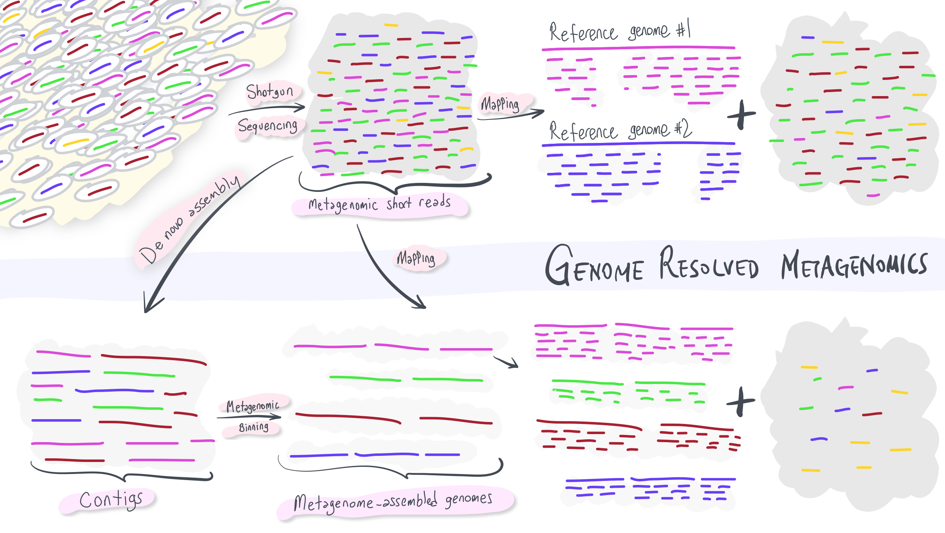
Notes:
In this case, we have better characterized the environment compared to the previous approach.
Q: Why are there still blue reads?
Q: What’s up with yellow? Which stage of the analysis may have failed?
Q: What else can we do to get the genome of yellow?

